Slide 1

Achieving Business Objectives and Goals with Observability
Jari Ala-Kurikka
Service Solutions Director

Slide 2
State of Observability
Vision and mission statement – little focus when the project starts
People, processes & tools – seldom focus on processes and people
Tool focus inhibits innovation – no embedding = no adoption
Monitoring ≠ Observability – we’re not implementing business cases
Observability - Vision and mission = Monitoring
DEVELOP
RELEASE
OPERATE
PREDICT
PREVENT
RESOLVE
PROTECT
IMPROVE

Slide 3










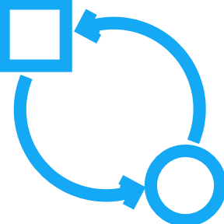


From strategy to results – real world business cases
Accountable providers perform better
Payment chains for different LOB’s, including external payment providers
Visibility & Remediation process in place
Not just performance, but SLA’s with penalties
+
=
Joint challenges have joint solutions
Disparate reseller frontends
Process in place for joint performance visibility
Real time third party performance transparency
+
=

Slide 4

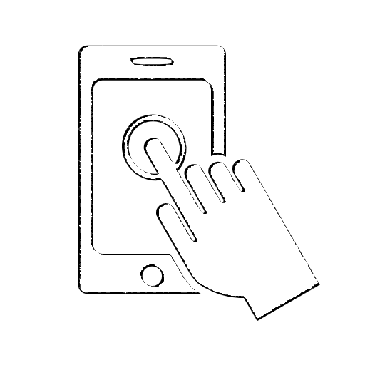


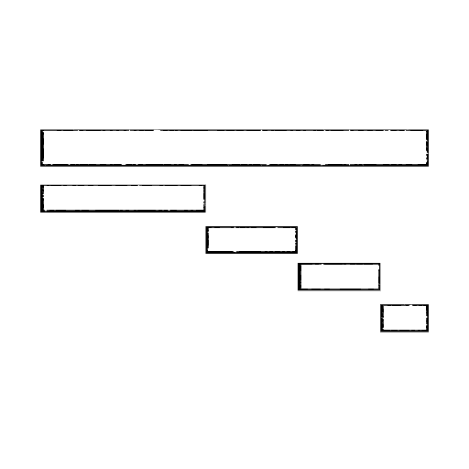









From strategy to results – real world success stories
Every step counts on the customer journey
Entire delivery chain, not just the order process
Holistic customer experience process in place with proactive actions for affected users
Complete business process visibility and enhanced customer experience
+
=
Stopping denial is the first step to improvement
Data driven decision making across silos
Process in place, building trust & breaking silos
Single pane of glass with no greenwashing
+
=

Slide 5
What does it take to be successful with Observability?
Success Planning
Roles & Responsibilities
Goals & Strategy
Architecture & Deployment
Architecture
Configuration
Enablement
Onboarding
Self-enablement
Process Integrations
Deployment
Training
Knowledge Sharing
Business Intelligence
Business Analytics
Security Analytics
Performance Analytics
Continuous Improvement
Repeatable Processes
Observability Practice
Innovation
Operationalizing
Operational Standards
Support
Use & Embed
Integration
Ways of Working
Collaboration
Automation
Establish Practices
Performance Engineering

Slide 6

Success Planning
Roles & Responsibilities
Goals & Strategy
Process Integrations
Ways of Working
Identify sponsor, owners and supporting staff
Create Plan and Define Ways of Working
Define Goals, Objectives and Timelines
Identify Process Integrations
Clear ownership
Efficient ways of working
Clear goals and timeline
Think ahead

Slide 7
Architecture & Deployment
Architecture
Define Dynatrace Architecture
Detail Ecosystem Integrations
Define & Automate Configuration
Deployment
Configuration
Automate Deployment of Servers & Agents
Integration
Ensure reliability
Ensure completeness
Act on data
Offer ease of use

Slide 8
Enablement
Onboarding
Facilitate User Orientation and Guided Learning
Facilitate Persona Based Learning and Certification
Ensure Guides, Education and Docs are available
Knowledge sharing
Self-enablement
Identify SME’s and Promote Best Practices Contribution
Training
Ensure a great start
Keep training relevant
Offer self-service
Offer use case support

Slide 9
Operationalizing
Operational Standards
Ensure Best Practices, Templates & Guides are Followed
Ensure Operational & End User Support is Available
Embed Observability into Activities & Processes
Promote Collaboration & Success Story Sharing Across Teams
Support
Use & Embed
Collaboration
Standard best practices
Continuous support
Embed into Processes
Promote collaboration

Slide 10
Business Intelligence
Business Analytics
Integrate with Business Analytics Platforms
Establish Security as a Service
Establish Performance First Practice
BizDevOps, DevSecOps, FinOps & CarbonOps
Security Analytics
Performance Analytics
Establish Practices
Data driven decisions
Safeguard your services
Optimize app performance
Establish proven practices

Slide 11
Continuous Improvement
Repeatable Processes
Create Blueprints and Workflows
Establish Observability Team & Enhance Global Standards
Introduce SRE
Observability Practice
Performance Engineering
Establish the Next Practice
Innovation
Introduce efficiencies
Provide Leadership
Close the DevOps loop
Define your own practice

Slide 12
Governance & Enablement Organization – Desired state
Vision
Knowledge
Solutions
Value
Sponsor & Steering group
Division A
SMEs
Division B
Dynatrace & Partners
Observability
Team
Internal
Clients
Division C
1000+
100+
10+
Division D
Division E
Biz Needs
SLAs
Innovation
Use Cases

Slide 13
Governance & Enablement Organization – Reality
Vision
Knowledge
Solutions
Value
Sponsor & Steering group
Division A
SMEs
Division B
(Dynatrace & Partners)
Observability
Team
Internal
Clients
Division C
1000+
0
1.5
Division D
Division E
Biz Needs
SLAs
Innovation
Use Cases

Slide 14










Maturity Assessment – Identifying your priorities
Observability
Survey
LEVEL 1
REACTIVE
Incident Management and Resolution
Current Observability State
Desired Observability State
LEVEL 2
AWARE
Software Delivery
LEVEL 3
EFFECTIVE
Organizational Priorities
LEVEL 4
OPTIMIZED
Business Analytics
LEVEL 5
PERVASIVE
Culture and Organization
Organizational Observability Stakeholders

Slide 15
The Maturity Assessment Framework
Aspect
Capabilities
Observability
Applications and Microservices
Logs and Infrastructure
Digital Experience Management
Cloud Monitoring
Application Security
Incident Management and Resolution
Production SLIs and SLOs
Change Management
CMDB Integration
Incident Management
Problem Remediation
Software Delivery
Pre-production SLIs and SLOs
Pre-production Quality Validation
Pipeline and Testing integration
Quality Analysis
Release Strategy
Business Analytics
Business Impact Instrumentation
User Journey Analytics
Business Release Validation
BI Tool Integration
Customer Care
Culture and Organization
Designated APM Specialist
Centralized Monitoring Practice
Onboarding and Configuration
Shared Services Practice
Self-Service Observability
Notes:
Look at key focus based on Roles – SRE Focus, ITOps

Slide 16


Hands-On Training Lab: Stockholm May 29-30 Waterfront Building Klarabergsviadukten 63, 111 64 Stockholm
Topics and use cases
Tenant Best Practices
Logs Management and Analytics​
Automated Incident Management
Business Events and Analytics
Application Security
FinOps and CarbonOps
Observability for Kubernetes
Release Validation
4 Flexpoints per attendee
2-day face-to-face event for practitioners
Led by Dynatrace Services Experts
Sign up here!

Slide 17
Thank you!
jari@dynatrace.com
Notes:
So the next three use cases that are present are actually working in our own environments this way, and we make it also accessible to you so that you can do and implement them to.

